Slide 1
Business Intelligence Project
Team 5
Members:
1.Bhavana Sinha(02804092018)
2.Shivani Giri(05404092018)
3.Arshiya(04604092018)
4.Sapna(0304092018)
5.Harshita(01904092018)
6.Akanksha(01304092018)

Slide 2
Personality Prediction Project
Project idea – The Myers Briggs Type Indicator is a personality type system that divides a person into 16 distinct personalities based on introversion, intuition, thinking and perceiving capabilities. We can identify the personality of a person from the type of posts they put on social media.

Slide 3
Four key dimensions that could be used to categorize people:
Introversion(I) vs. Extraversion(E)
Sensing(S) vs. Intuition(N)
Thinking(T) vs. Feeling(F)
Judging(J) vs. Perceiving(P)
So for example, someone who prefers introversion, intuition, thinking and perceiving would be labelled an INTP in the MBTI system, and there are lots of personality based components that would model or describe this person’s preferences or behaviour based on the label.

Slide 4
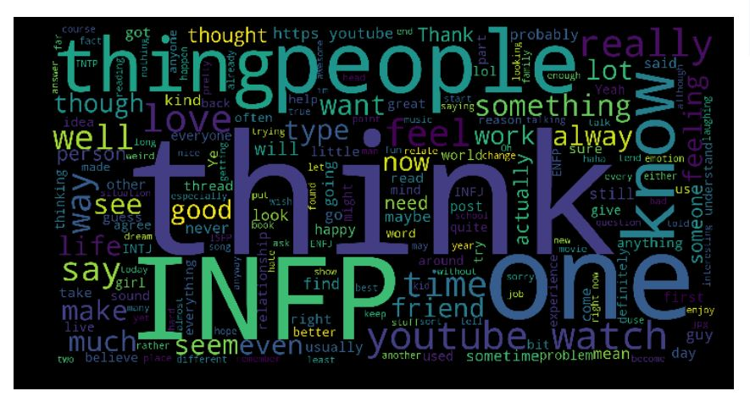
How do social media posts matter?
Let’s check the most popular words in some personality types:
People with INFP personality type use these words:

Slide 5
Dataset
The dataset contains over 8600 rows of data, on each row is a person’s:
Type (This persons 4 letter MBTI code/type)
A section of each of the last 50 things they have posted (Each entry separated by "|||" (3 pipe characters)

Slide 6
Acknowledgements
This data was collected through the PersonalityCafe forum, as it provides a large selection of people and their MBTI personality type, as well as what they have written.
Source : https://www.kaggle.com/datasnaek/mbti-type

Slide 7
Modifications can be made in dataset
Assertive
Turbulence

Slide 8
Thank you!

